Slide 1

SRM INSTITUTE OF SCIENCE AND TECHNOLOGY
Ramapuram , Chennai – 600 089
FACULTY OF ENGINEERING AND TECHNOLOGY
DEPARTMENT OF ECE
MAJOR PROJECT
PROJECT EVALUATION – FINAL REVIEW
IMAGE TRANSMISSION BASED OFDM CHANNEL ESTIMATION OVER DWT BASED CARRIER MODULATION TECHNIQUE
BATCH NUMBER : 10
Team Members | Supervisor
L.H Prajwal - RA2211004020161 B.Abhinandhan - RA2211004020170 K. Sumadhar - RA2211004020173 Gutta Tharun - RA2211004020198 | Name: Dr. A.MOHANBABU Designation: Assistant Professor Department: ECE

Slide 2
AGENDA
ABSTRACT
INTRODUCTION
OBJECTIVES
LITERATURE SURVEY
METHODOLOGY
EXISTING SYSTEM
PROPOSED SYSTEM
BLOCK DIAGRAM
CODE
OUTPUT
CONCLUSION
REFERENCES

Slide 3
ABSTRACT
In modern wireless communication systems, the reliable transmission of multimedia data such as images is a major challenge due to noise, interference, and channel fading. Orthogonal Frequency Division Multiplexing (OFDM) is widely used to overcome these issues because of its high data rate capability and robustness against multipath fading. However, conventional OFDM systems based on Fast Fourier Transform (FFT) suffer from high Peak-to-Average Power Ratio (PAPR) and spectral inefficiency.This project presents a basic-level study of image transmission using OFDM with Discrete Wavelet Transform (DWT)–based carrier modulation and channel estimation. DWT-based OFDM replaces the conventional FFT with wavelet transforms, resulting in better spectral efficiency and reduced PAPR. Channel estimation techniques are applied to estimate channel characteristics and improve image reconstruction quality at the receiver. The proposed system demonstrates improved performance in terms of image quality, noise resistance, and efficient bandwidth utilization.

Slide 4
INTRODUCTION
With the rapid growth of wireless communication technologies, the demand for high-quality multimedia transmission has increased significantly. Image transmission plays a vital role in applications such as medical imaging, satellite communication, surveillance systems, and wireless multimedia services. However, transmitting images over wireless channels is challenging due to noise, interference, and multipath fading, which can distort the received image.Orthogonal Frequency Division Multiplexing (OFDM) is a popular modulation technique used in modern communication systems such as LTE, Wi-Fi, and digital broadcasting. OFDM divides the available bandwidth into multiple orthogonal subcarriers, allowing parallel data transmission. This makes OFDM highly resistant to inter-symbol interference caused by multipath propagation. Despite its advantages, traditional FFT-based OFDM systems suffer from drawbacks such as high Peak-to-Average Power Ratio (PAPR) and sensitivity to synchronization errors.To overcome these limitations, Discrete Wavelet Transform (DWT)–based OFDM has been introduced. In DWT-based OFDM, wavelet transforms are used instead of FFT to generate subcarriers. This approach provides better time-frequency localization, improved spectral efficiency, and reduced PAPR. As a result, DWT-based OFDM is more suitable for efficient image transmission over wireless channels.Another critical aspect of wireless communication is channel estimation.

Slide 5
OBJECTIVES
To study image transmission using OFDM.
To understand DWT-based carrier modulation technique.
To analyze basic channel estimation methods.
To improve received image quality.
To compare performance with conventional OFDM systems.

Slide 6
LITERATURE SURVEY
SI. No | Title of the Paper | Published Journal and Year | Author | Concept | Inference
1 | Image Transmission Through OFDM Channel with Noise Estimation | International Journal of Future Generation Communication and Networking, 2017 | R. Kaur, S. Singh | Image transmission using OFDM system, noise estimation, BER and PSNR analysis | Improves image reconstruction quality but performance decreases under severe channel noise.
2 | Performance Analysis of DWT-OFDM and FFT-OFDM using Various Modulation Techniques | International Journal of Computer Applications, 2015 | P. Manhas, M. K. Soni | Comparison of FFT-OFDM and DWT-OFDM, evaluation using BER and channel coding techniques | DWT-OFDM improves spectral efficiency and reduces interference compared to conventional OFDM systems.

Slide 7
LITERATURE SURVEY
SI.No | Title of the Paper | Published Journal and Year | Author | Concept | Inference
3 | Image Transmission in 4G LTE Using DWT Based SC-FDMA System | Biomedical & Pharmacology Journal, 2018 | V. M. Padmapriya | DWT based wireless image transmission, performance analysis using BER, PSNR and SNR | Wavelet transform improves noise resistance and reduces error rate in wireless communication.
4 | Channel Estimation of DWT Based MIMO-OFDM System | Indian Journal of Science and Technology, 2016 | S. Sharma, R. Mehta | Replacement of FFT/IFFT with DWT/IDWT in OFDM systems, channel estimation in MIMO-OFDM | DWT based OFDM provides better BER performance and improved spectral efficiency in multipath channels.

Slide 8
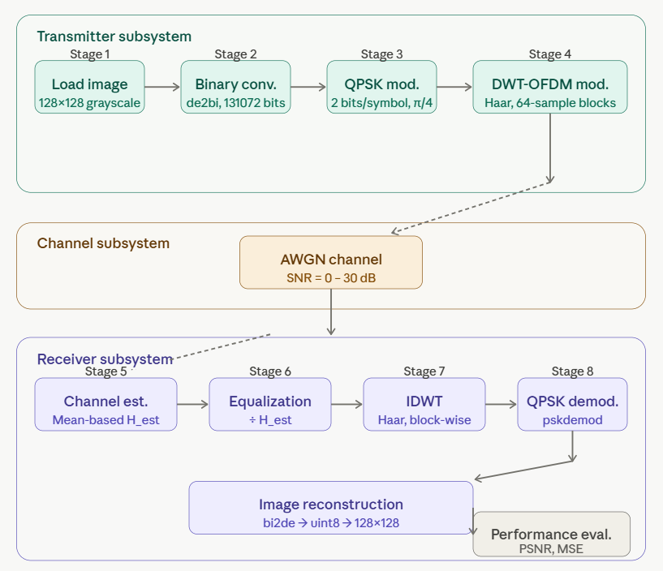
METHODOLOGY

Slide 9
METHODOLOGY
[1] Input Image Selection
The original image is selected and converted into a digital format suitable for
transmission.
[2 ]Image to Binary Conversion
The image pixels are converted into a binary data stream for modulation.
[3] DWT-Based OFDM Modulation
Discrete Wavelet Transform (DWT) is applied instead of FFT to generate OFDM
subcarriers and modulate the data.
[4] Pilot Insertion for Channel Estimation
Pilot symbols are inserted into the transmitted signal to estimate channel characteristics.

Slide 10
METHODOLOGY
[5] Transmission Through Wireless Channel
The modulated signal is transmitted through a simulated noisy wireless channel.
[6] Channel Estimation and Equalization
At the receiver, channel estimation is performed to reduce channel distortion.
[7] OFDM Demodulation Using DWT
The received signal is demodulated using inverse DWT to recover transmitted data.
[8]Image Reconstruction
The binary data is converted back to pixel values to reconstruct the received image.

Slide 11
EXISTING SYSTEMS
ADVANTAGES OF EXISTING SYSTEM
Image transmission using FFT-based OFDM.
Limited resistance to noise and fading.
Higher PAPR.
Basic channel estimation techniques
DISADVANTAGES OF EXISTING SYSTEM:
Degraded image quality under noise.
High PAPR causing power inefficiency.
Spectral leakage.
Reduced performance in multipath channels.

Slide 12
PROPOSED SYSTEM
The proposed system uses DWT-based OFDM for image transmission. The input image is converted into a binary data stream and modulated using DWT-based OFDM. Pilot symbols are inserted for channel estimation. At the receiver, channel estimation and equalization are performed to reduce channel distortion. The received data is demodulated and reconstructed into the original image. This approach improves spectral efficiency and image quality.
ADVANTAGES OF PROPOSED SYSTEM:
Improved image quality.
Reduced PAPR.
Better spectral efficiency.
Improved performance in noisy channels.
Simple and efficient implementation.

Slide 13

TOOLS REQUIRED
MATLAB – Primary simulation and development environment for signal processing and image analysis.
Image Processing Toolbox - For reading, displaying, and processing grayscale images.
Communications Toolbox – For modulation (QPSK), channel modeling (AWGN), and channel estimation.
Wavelet Toolbox – For implementing DWT (Haar wavelet) and IDWT operations.
MATLAB GUIDE / UI control – For building the interactive Graphical User Interface (GUI).

Slide 14
CODE
function main_code
clc; close all;
%% ===================FIGURE===================
f = figure('Name','DWT-OFDM Image Transmission',...
'Position',[100 50 1200 650],'Color',[0.95 0.95 0.95]);
%%=================== AXES====================
handles.ax1 = axes('Parent',f,'Position',[0.05 0.55 0.2 0.35]); % Original
title('Original Image')
handles.ax2 = axes('Parent',f,'Position',[0.28 0.55 0.2 0.35]); % TX Signal
title('Transmitter Output');
handles.ax3 = axes('Parent',f,'Position',[0.51 0.55 0.2 0.35]); % Channel
title('Channel Output');
handles.ax4 = axes('Parent',f,'Position',[0.74 0.55 0.2 0.35]); % Received Image
title('Received Image');
handles.ax5 = axes('Parent',f,'Position',[0.3 0.1 0.4 0.3]); % Performance Graph
title('Performance Graph');

Slide 15
CODE
%% =================TITLE=========================
uicontrol('Style','text','String','DWT-OFDM IMAGE TRANSMISSION SYSTEM',...
'Units','normalized','Position',[0.3 0.95 0.4 0.05],...
'FontSize',14,'FontWeight','bold','BackgroundColor',[0.23 0.4 0.15 0.06]);
%% ================BUTTONS=======================
btn_color = [0.2 0.6 0.8];
uicontrol('Style','pushbutton','String','1. Load Image',...
'Units','normalized','Position',[0.06 0.45 0.17 0.06],...
'BackgroundColor',btn_color,'Callback',@loadImage);
uicontrol('Style','pushbutton','String','2. Transmitter',...
'Units','normalized','Position',[0.3 0.45 0.17 0.06],...
'BackgroundColor',btn_color,'Callback',@transmitter);
uicontrol('Style','pushbutton','String','3. Channel',...
'Units','normalized','Position',[0.52 0.45 0.17 0.06],...
‘BackgroundColor',btn_color,'Callback',@channel);
uicontrol('Style','pushbutton','String','4. Receiver',...
'Units','normalized','Position',[0.76 0.45 0.17 0.06],...

Slide 16
CODE
'BackgroundColor',btn_color,'Callback',@receiver);
uicontrol('Style','pushbutton','String','5. Performance',...
'Units','normalized','Position',[0.06 0.25 0.17 0.06],...
'BackgroundColor',btn_color,'Callback',@performance);
%% ===================STATUS=====================
handles.status = uicontrol('Style','text','String','Status: Ready',...
'Units','normalized','Position',[0.3 0.02 0.4 0.05],...
'FontSize',12,'FontWeight','bold','BackgroundColor',[0.25 0.4 0.25 0.46]);
guidata(f,handles);
end

Slide 17
CODE
%% ================= FUNCTIONS =================
function loadImage(hObject,~)
handles = guidata(hObject);
[file,path] = uigetfile({'*.jpg;*.png;*.tif'});
img = imread(fullfile(path,file));
if size(img,3)==3
img = rgb2gray(img);
end
img = imresize(img,[128 128]);
axes(handles.ax1); imshow(img);
handles.img = img;
handles.status.String = 'Image Loaded';
guidata(hObject,handles);
end

Slide 18
CODE
%% ===============TRANSMITTER====================
function transmitter(hObject,~)
handles = guidata(hObject);
img = handles.img;
img_data = double(img(:));
bin_data = de2bi(img_data,8,'left-msb');
tx_bits = bin_data(:);
symbols = bi2de(reshape(tx_bits,[],2));
mod_data = pskmod(symbols,4,pi/4);
block_size = 64;
num_blocks = ceil(length(mod_data)/block_size);
pad_len = num_blocks*block_size - length(mod_data);
mod_data = [mod_data; zeros(pad_len,1)];
mod_blocks = reshape(mod_data,block_size,[]);
dwt_tx = [];

Slide 19
CODE
for k=1:size(mod_blocks,2)
[cA,cD] = dwt(real(mod_blocks(:,k)),'haar');
dwt_tx = [dwt_tx; cA; cD];
end
axes(handles.ax2);
plot(dwt_tx(1:200)); % show part of signal
title('Transmitter Output');
handles.tx_bits = tx_bits;
handles.dwt_tx = dwt_tx;
handles.status.String = 'Transmitter Done';
guidata(hObject,handles);
end

Slide 20
CODE
=============CHANNEL====================
function channel(hObject,~)
handles = guidata(hObject);
dwt_tx = handles.dwt_tx;
snr = 20;
rx_signal = awgn(dwt_tx,snr,'measured')
axes(handles.ax3);
plot(rx_signal(1:200));
title('Channel Output');
dwt_tx(abs(dwt_tx)<1e-6)=1e-6;
H_est = mean(rx_signal ./ dwt_tx);
eq_signal = rx_signal ./ H_est;
eq_signal(~isfinite(eq_signal))=0;
handles.eq_signal = eq_signal;
handles.status.String = 'Channel Done';
guidata(hObject,handles);
end

Slide 21
CODE
====================RECEIVER==============
function receiver(hObject,~)
handles = guidata(hObject);
eq_signal = handles.eq_signal;
tx_bits = handles.tx_bits;
img = handles.img;
block_size = 64;
rec_blocks = [];
idx = 1;
num_blocks = length(eq_signal)/block_size;
for k=1:num_blocks
cA = eq_signal(idx:idx+(block_size/2-1));
cD = eq_signal(idx+(block_size/2):idx+block_size-1);
idx = idx + block_size;
cA(~isfinite(cA))=0;
cD(~isfinite(cD))=0;

Slide 22
CODE
rec_block = idwt(cA,cD,'haar');
rec_blocks = [rec_blocks; rec_block];
end
rec_signal = rec_blocks(:);
demod = pskdemod(rec_signal,4,pi/4);
rx_bits = de2bi(demod,2);
rx_bits = rx_bits(:);
rx_bits = rx_bits(1:length(tx_bits));
rx_pixels = bi2de(reshape(rx_bits,8,[]).','left-msb');
rx_img = reshape(uint8(rx_pixels),size(img));
axes(handles.ax4);
imshow(rx_img);
handles.rx_img = rx_img;
handles.status.String = 'Receiver Done';
guidata(hObject,handles);
end

Slide 23
CODE
=============PERFORMANCE============
function performance(hObject,~)
handles = guidata(hObject);
img = handles.img;
rx_img = handles.rx_img;
mse_val = immse(img,rx_img);
psnr_val = psnr(rx_img,img);
==================Show values===========
msgbox(sprintf('MSE: %.4f\nPSNR: %.2f dB',mse_val,psnr_val));
% Graph (SNR vs PSNR)
snr_range = 0:5:30;
psnr_vals = zeros(size(snr_range));
for i=1:length(snr_range)
noisy = awgn(double(img),snr_range(i),'measured');
psnr_vals(i) = psnr(uint8(noisy),img);
end

Slide 24
CODE
axes(handles.ax5);
plot(snr_range,psnr_vals,'-o');
xlabel('SNR');
ylabel('PSNR');
title('Performance Graph');
handles.status.String = 'Performance Displayed';
guidata(hObject,handles);
end

Slide 25
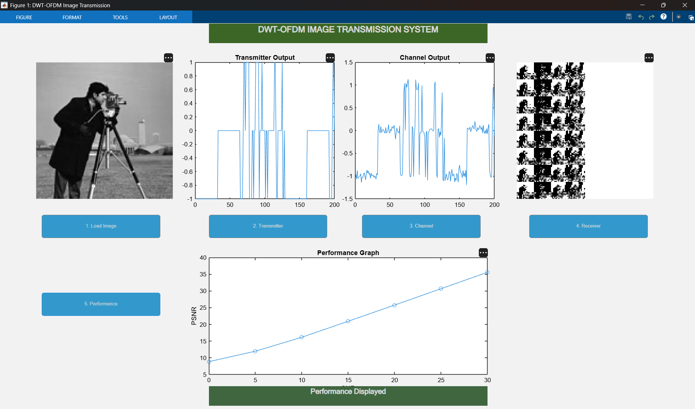
OUTPUT

Slide 26
CONCLUSION
This project studied image transmission using OFDM with DWT-based carrier modulation and channel estimation.
The proposed DWT-OFDM system improves spectral efficiency and reduces Peak-to-Average Power Ratio (PAPR) compared to conventional FFT-based OFDM.
Channel estimation techniques help in reducing channel distortion and improving received image quality.
The system shows better noise resistance and efficient bandwidth utilization in wireless communication environments.
Overall, the proposed approach demonstrates that DWT-based OFDM is an effective technique for reliable multimedia transmission over wireless channels.

Slide 27
REFERENCES
M.K Lakshmanan and H.Nikoobar, “A review of wavelets for digital wireless communication”, Journal on Wireless Personal Communication, Vol.37, no.3-4, pp.387- 420, Springer, May 2006.
C.Christopoulos, A. Skodras, and T.Ebrahimi,”The JPEG2000 still image coding system: An overview”, IEEE Transaction Consumer Electron, Vol.46, no.4, pp.1103-127, Nov 2000.
Y.Li and G.L.Stueber, “Orthogonal frequency division multiplexing for wireless communication”, Springer, 2005.
S.Weinstein and P.Ebert, “Data transmission by Frequency Division Multiplexing using the Discrete Fourier Transform”, IEEE Transaction on Communication Technology, Vol.19, no.5, pp.628-634, Oct1971.
Radhika v. Totala, K.S.Bapat, “Comparative Analysis of Watermarking in Digital Images Using DCT& DWT”, International Journal of Scientific and Research Publications, Vol.3, ISSN 2250-3153, Feb 2013.

Slide 28
REFERENCES
M. Mozammel Hoque Chowdhury and Amina Khatun, “Image Compression Using Discrete Wavelet Transform”, IJCSI International Journal of Computer Science Issues, Vol.9, no.1, Jul 2012.
Y.Li, “Pilot-symbol-aided channel estimation for OFDM in Wireless systems”, IEEE Trans.Veh.Techn, Vol.49, no.4, pp.1207-215, Jun 2000.
Ashwani Sharma, Swades De, and Hari Mohan Gupta,”Energy Efficient transmission of DWT image over OFDM fading channel, Communications Systems and Networks (COMSNETS, 2011 Third International Conference on, Vol.; no., pp.1, 7,4-8, Jan 2011.
J.McEliece and W.E.Stark, “Channels with block interference”, IEEE Transaction information .Theory, Vol.30, no.1, pp.44-53, Jan 1984.
R.Knopp and P.A.Humblet, “On coding for block fading channels”, IEEE Trans.info.Theory, Vol.46, no.1, pp.189-205, Jan 2000.

